Slide 1
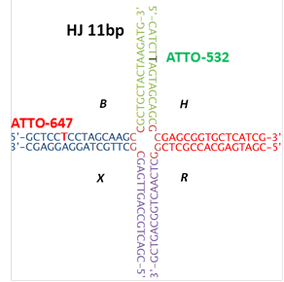
HJ 11 – HPLC
Column: Clarity 3u OligoRP 50x4.6mm
Tempreture: 23C
sequence | bases | Strand name
GCTCCTCCTAGCAAGCCGCTGCTACTAAGATG | 32 | B-acceptor
CATCTTAGTAGCAGCGCGAGCGGTGCTCATCG | 32 | H-donor
CGATGAGCACCGCTCGGCTCAACTGGCAGTCG | 32 | R
CGACTGCCAGTTGAGCGCTTGCTAGGAGGAGC | 32 | X
CGATGAGCACCGCTCGGCTTGCTAGGAGGAGC | 32 | HJ 3rd leg

Slide 2
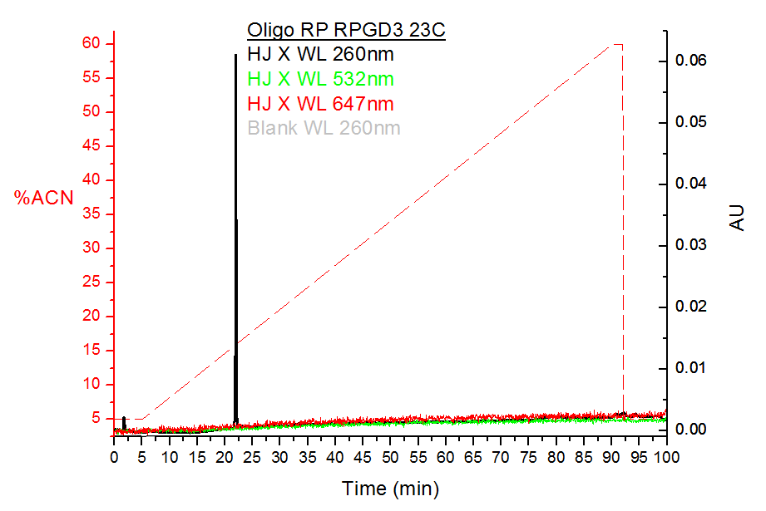
X – Only, 12.5pmol
22.0min
Not DNA

Slide 3
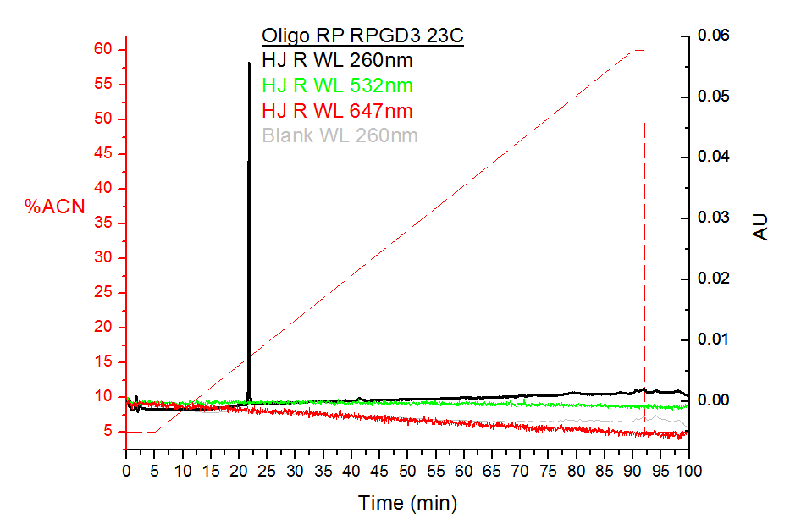
R – Only, , 12.5pmol
Not DNA
21.75min

Slide 4
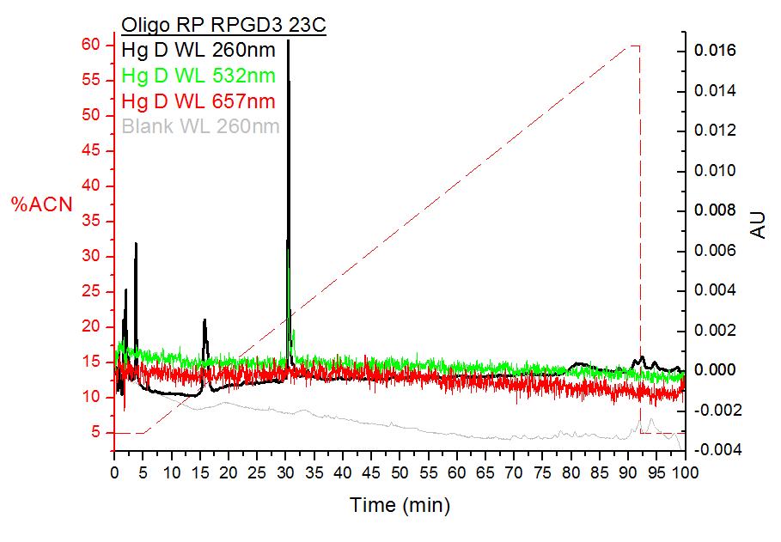
H – Only, Donor Labeled, 12.5pmol

Slide 5
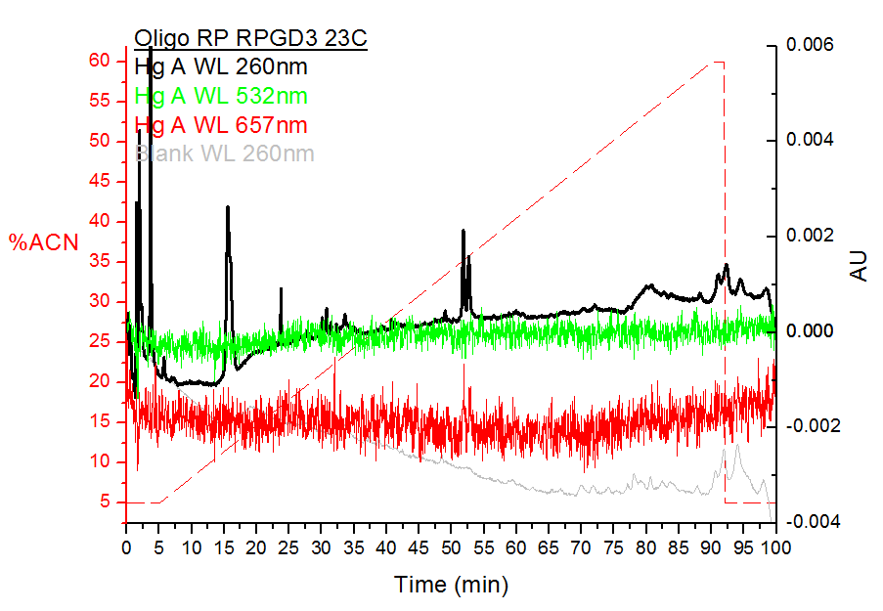
B – Only, Acceptor Labeled, 12.5pmol

Slide 6
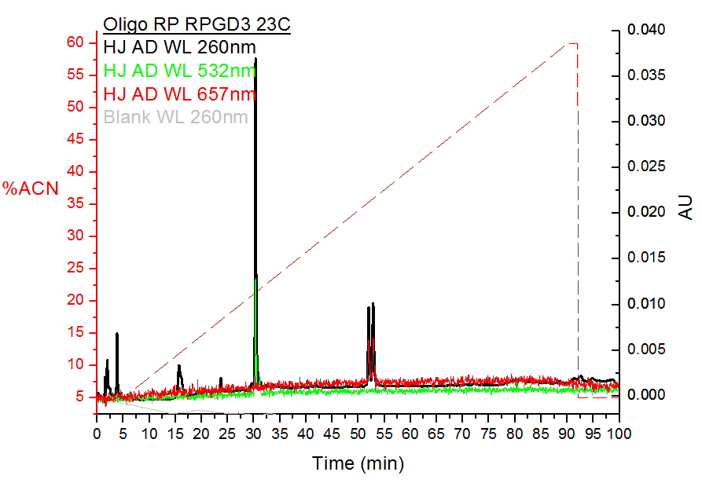
H B annealed (Donor Acceptor)

Slide 7
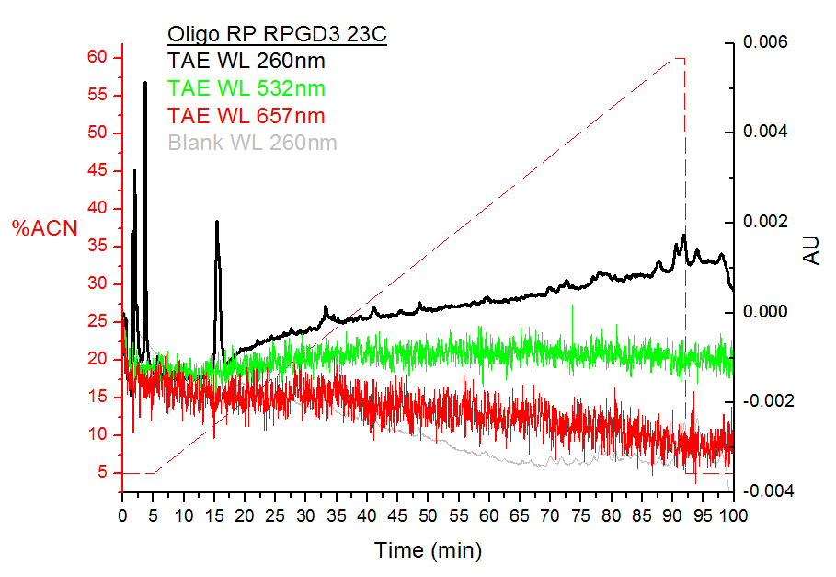
TAE only, 45.4uL
TAE shows pick at ~15min WL 290nm

Slide 8
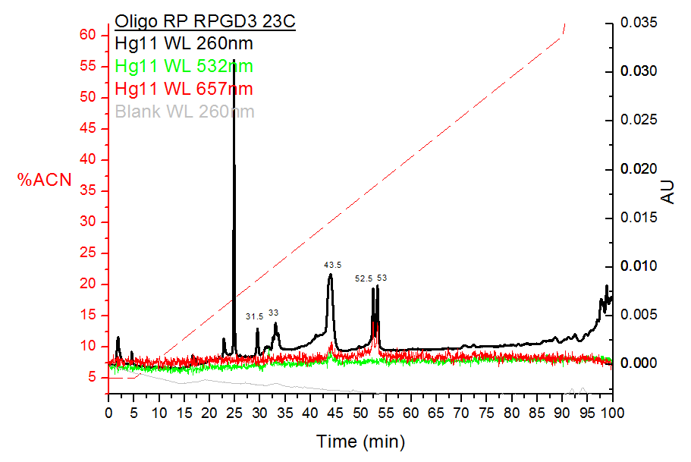
HJ 11 Annealed
Stoichiometry:
R:H:X:B ->
1.5X:1X:1.5X:1.5X
1
7
1: DNA only. Probably ss, correspond to other measurements with similar length
31.5-53 refers to containing eppendorfs
7: In the last 10min Gradient was increased to 100% ACN. Majority of DNA was ejected after 100min.

Slide 9
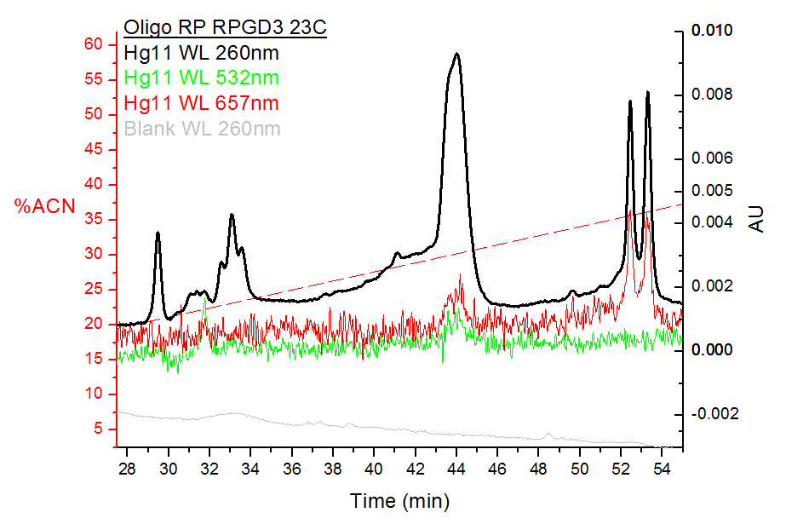
5
6
4
2
3
2, 4: DNA only. Could be ds
3: Atto 532 & DNA
5: DNA & both dyes
6: Atto 647 & DNA, correspond to ss dyed around the same length

Slide 10
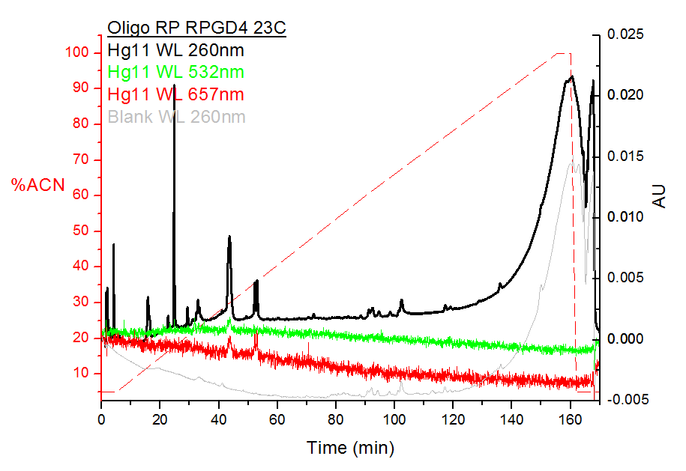
1
Continues of ACN gradient to 100% to verify no more DNA.
1: Pick was collected and put on set up

Slide 11
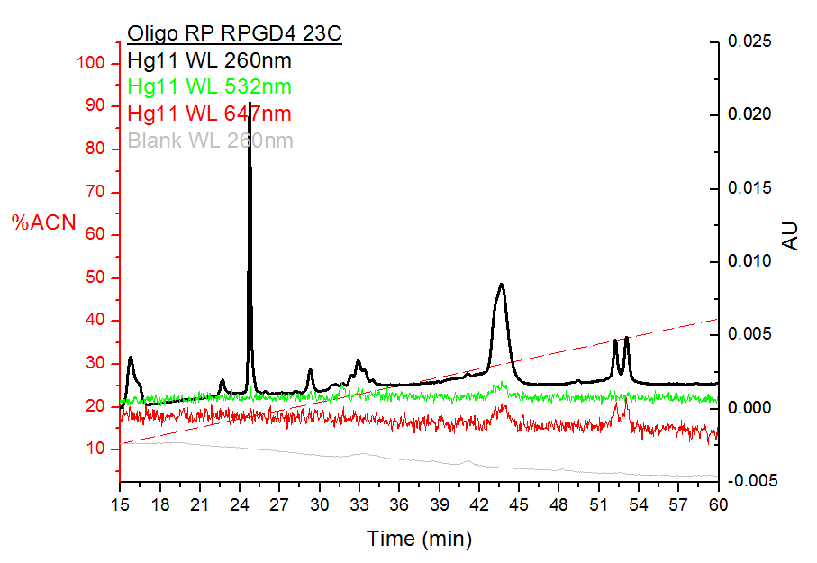
Holiday Junction
TAE

Slide 12
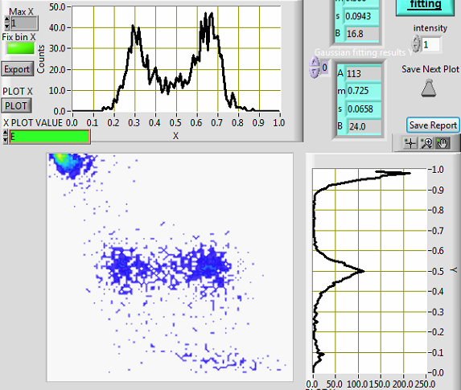
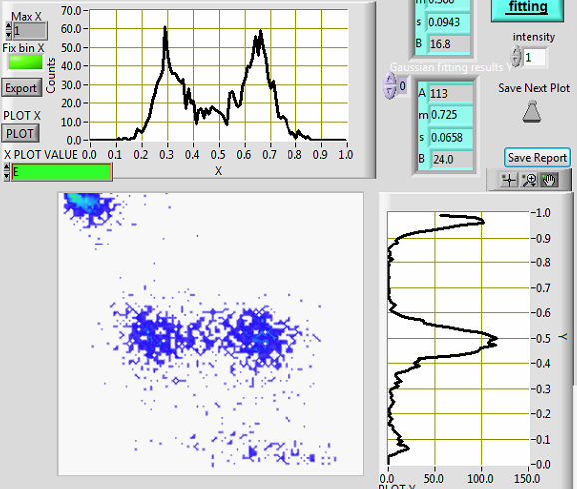
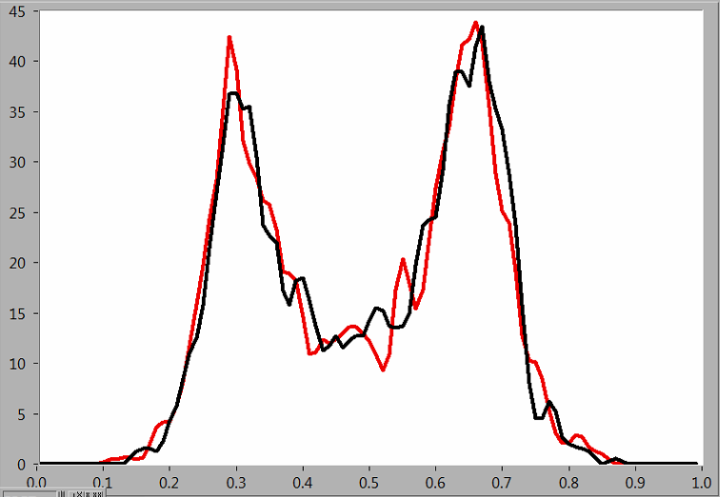
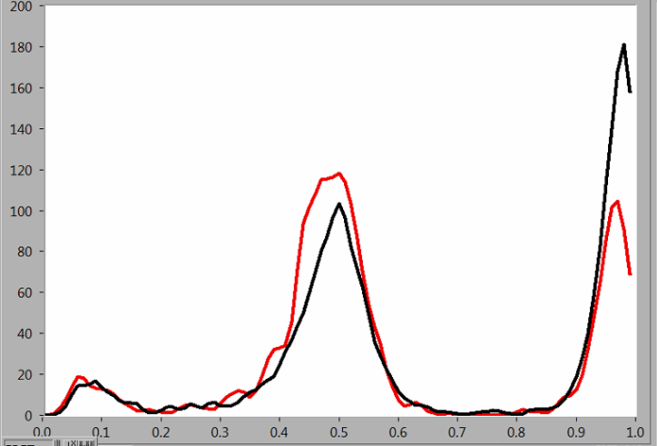
Stoichiometry:
R:H_donor:X:B_acceptor ->1.5X:1X:1.5X:1.5X
Hadas ran 12.5 pMolar in HPLC and collected peak 43.5 min
Same sample After HPLC clean,
peak 43.5 min
REFERENCE, After annealing in 250 nM
FRET
ALEX

Slide 13
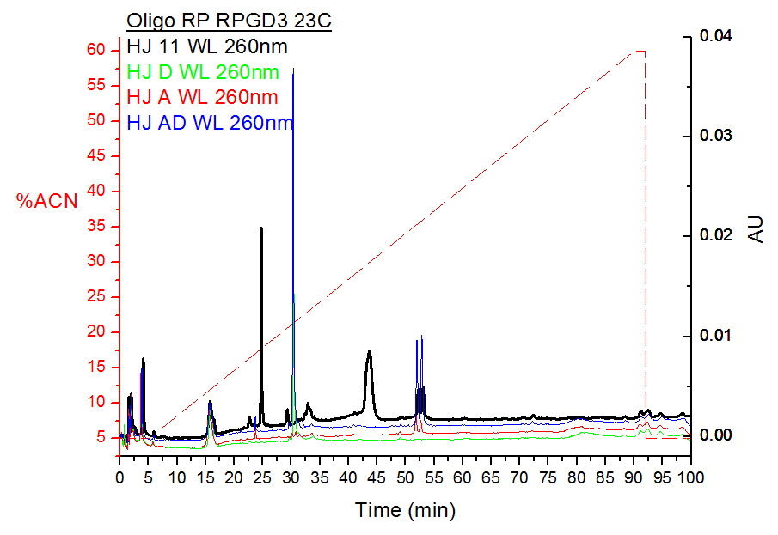
All plots combined WL 260nm. Shifts of less then 1min between plots

Slide 14
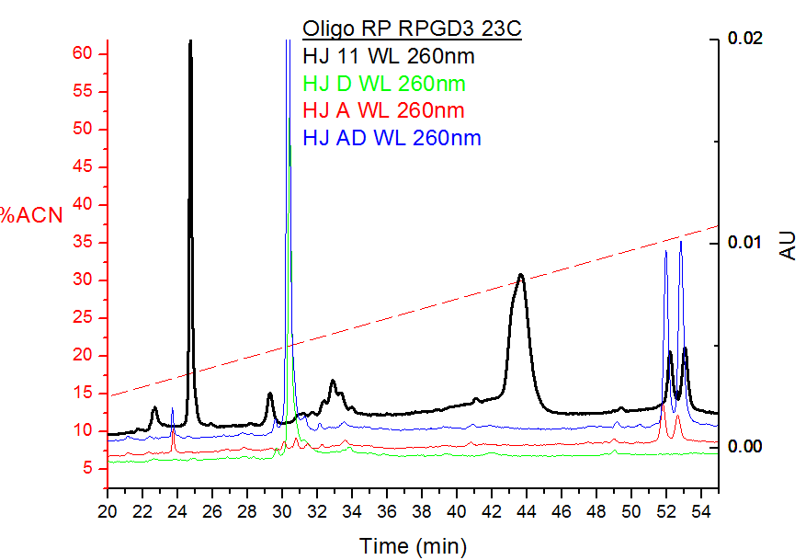
4
5
1
2
3
215nm pick
Plot slide 9 zoom
1,3: Probably ss and ds undyed
2: Donor only, shift of ~2min
4: Holiday Junction
5: Acceptor only, shift of ~1min

Slide 15
Next runs:
Undyed strands (R&X) alone and together after annealing
Drying Holiday junction and running again

